Slide 1
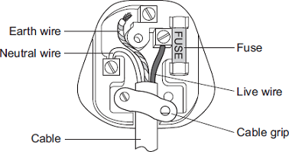
a) The diagram shows the inside of an incorrectly wired three-pin plug.
(i) What two changes need to be made so that the plug is wired correctly? – The earth wire is not connected to the screw and the same for the cable grip
(ii) The fuse inside a plug is a safety device. – The fuse is a safety device so that if excess current is passed on to the circuit, the fuse will melt and the circuit will break to ensure safety
Explain what happens when too much current passes through a fuse – When excess current passes through a fuse, it will melt and in turn break the circuit so that the excess current doesn’t give us an electric shock

Slide 2
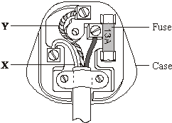
(b) The diagram shows the inside of a correctly wired three-pin plug.
(i) What colour is the insulation on the wire labelled X? - Blue
(iii) What material would be suitable for the case of the plug? -
Insulating material such as plastic is the most suitable for the cover of the plug so that we don’t get an electric shock

Slide 3

Fuses(c)
Question if a Hair Drier has a current of 4 amps running through it, which size fuse should you use? (1)
3 Amp
5 Amp
15 Amp

